Slide 1

DriverPass System Analysis
Franco Espinoza
Notes:
Remember to smile!

Slide 2

System Requirements
Functional Requirements
Enable customers to choose from our three driving package options.
Enable customers to book their sessions online
Nonfunctional Requirements
Adaptability
System Performance
Notes:
Functional requirements define what the system must do, while nonfunctional requirements describe the system’s qualities and operational constraints.
The first functional requirement is the system’s ability to let customers choose one of three driving packages. After logging into the DriverPass portal, customers select a package and are directed to a secure payment page. Once payment is completed, the system grants access to the lesson‑scheduling features.
The second functional requirement is the ability for students to book driving lessons online. After signing in, customers can view the scheduling calendar and reserve an available time slot. Any previously booked lessons are automatically blocked to prevent double‑booking.
Nonfunctional requirements describe how the system should operate. The first nonfunctional requirement is adaptability. All system data must be stored securely on the backend and accessible only to authorized IT administrators. These administrators manage the server environment, database, and all components responsible for system maintenance and security.
The second nonfunctional requirement is system performance. Because the client requested a cloud‑based web environment, the system must remain scalable and cost‑effective as the business grows. Performance expectations include minimal latency during navigation and regular bi‑weekly or monthly updates to ensure reliability and alignment with evolving business needs.

Slide 3
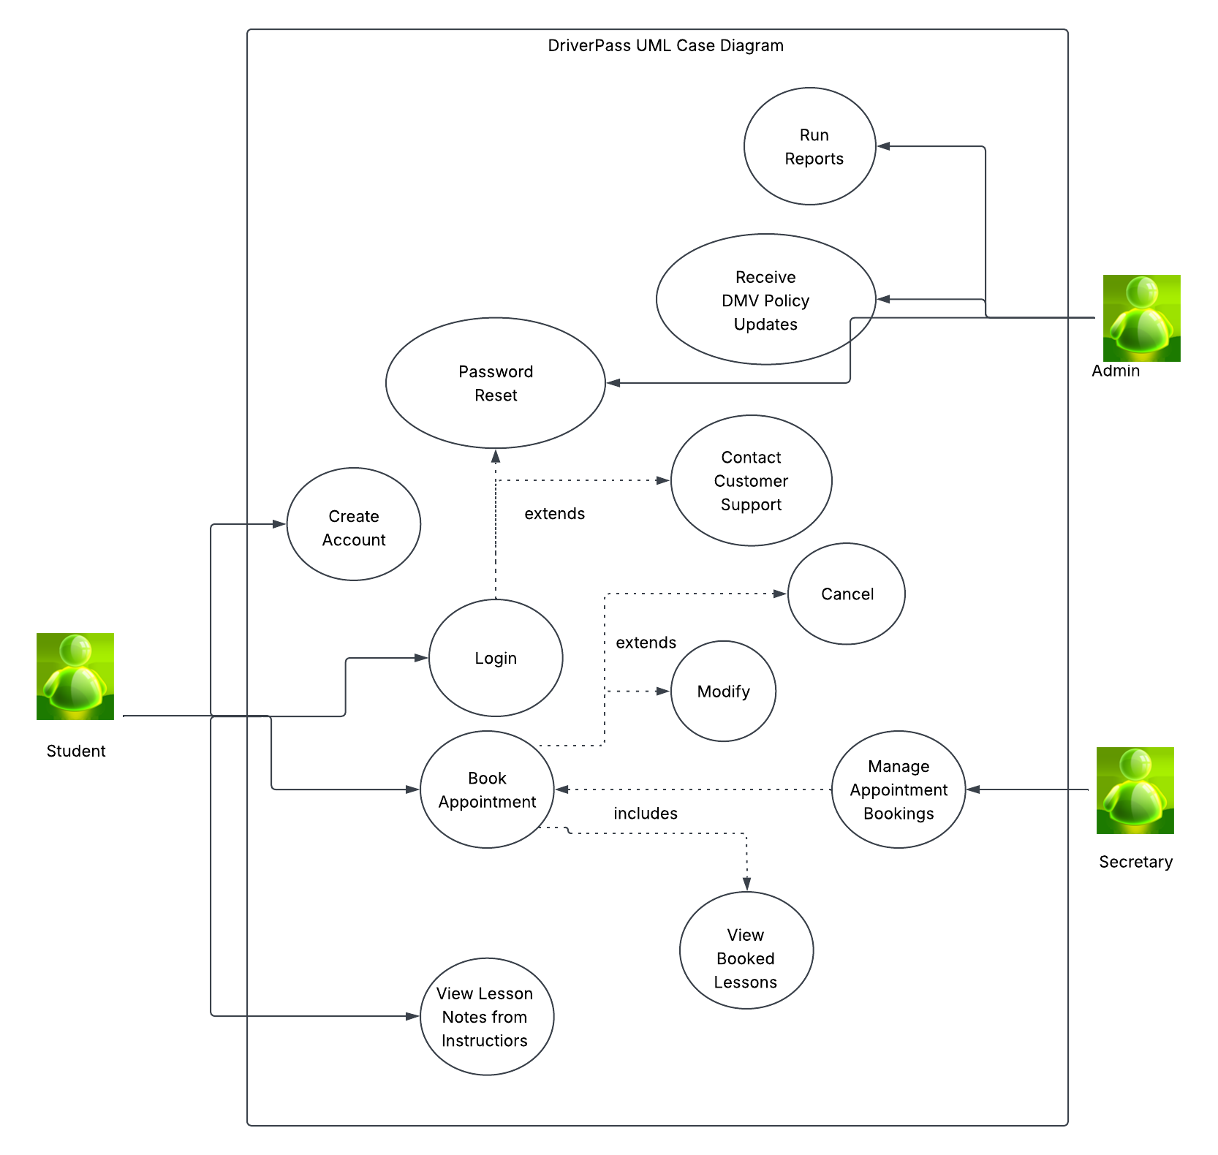
Use Case Diagram
Notes:
The system involves three primary actors: customers, administrative staff, and secretaries. Customers can create accounts, book and modify appointments, review instructor lesson notes, contact support, and reset their passwords. Administrators can run system reports, receive DMV policy updates, and assist customers by resetting account credentials. Secretaries are responsible for managing appointment bookings.
This structure ensures each actor performs only the operations relevant to their role. Access is controlled through unique login credentials, limiting users to the information and functions they are authorized to view. For example, secretaries can manage scheduling but cannot access customer payment data, and customers can only view information associated with their own accounts.

Slide 4
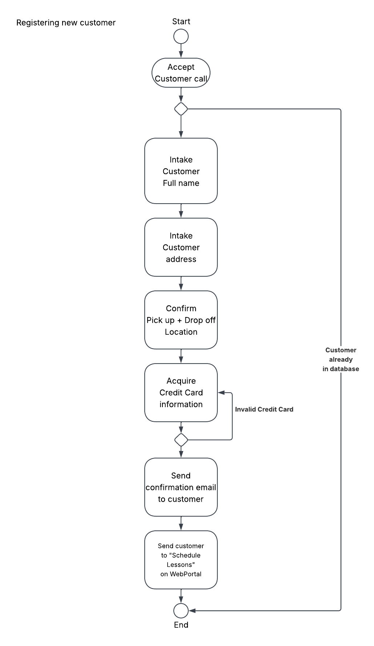
Activity Diagram
Notes:
This process illustrates how the system functions when a customer calls the administrative team to register and enroll in driving lessons. The customer begins by speaking with a secretary, who searches for their name in the system to determine whether an account already exists. If the customer is already registered, no additional intake is required. If not, the secretary collects the customer’s full name, address, pick‑up and drop‑off locations, and credit card information.
The system then verifies the credit card data. If verification fails, registration cannot proceed. If the payment information is validated, the system completes the registration and sends a confirmation to the customer. The customer is then prompted to log in to the secure web portal and schedule their lessons.

Slide 5
Security
Addressing security concerns
Case-sensitive passwords
Multi-factor identification
No more than three failed attempts to login.
Notes:
Implementing strong security measures begins with establishing clear parameters for all system logins. Every user (customers and administrators) must have a unique account to access the DriverPass system. Each account requires a personal email as the username and a case‑sensitive password.
To protect sensitive information, such as customer addresses, payment data, and administrative access to reports and scheduling tools, the system will use multi‑factor authentication. This verification method ensures that the person attempting to log in is the legitimate account holder. After entering their credentials, users receive a system‑generated passcode via text or email, which must be entered to complete authentication.
If a user forgets their password, they can reset it through a link on the login page or request assistance from an IT administrator. The system also enforces a security limit on login attempts. After three failed attempts, the account is locked. An IT administrator must then unlock the account, ensuring that any unusual activity is reviewed for potential unauthorized access.

Slide 6
System Limitations
Time
Budget
Technology
Resources
Notes:
Our first limitation is time. The project must be completed between August 17 and January 4, which requires careful planning and efficient task management. The second limitation is budget, determined by what the client can allocate. Budget directly influences the next two limitations: technology and resources.
Technology limitations include the hardware available to administrative staff and the devices customers use to access the system. For example, older mobile devices may not support the browsers required for the DriverPass platform. Resource limitations refer to the number of skilled technical personnel who can be assigned to the project and the level of efficiency expected during development and deployment. Both technology and resource availability are shaped by the overall budget.

